Slide 1
Software Quality

Slide 2
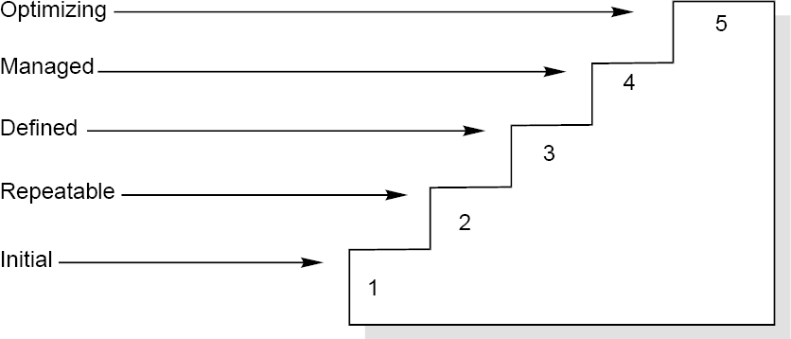
Software Quality
Capability Maturity Model
It is a strategy for improving the software process, irrespective of the actual life cycle model used.
Fig. : Maturity levels of CMM

Slide 3
Software Quality
Maturity Levels:
Initial (Maturity Level 1)
Repeatable (Maturity Level 2)
Defined (Maturity Level 3)
Managed (Maturity Level 4)
Optimizing (Maturity Level 5)

Slide 4
Software Quality
Maturity Level | Characterization
Initial | Adhoc Process
Repeatable | Basic Project Management
Defined | Process Definition
Managed | Process Measurement
Optimizing | Process Control
Fig. : The five levels of CMM

Slide 5
Software Quality
ISO 9000
The SEI capability maturity model initiative is an attempt to improve software quality by improving the process by which software is developed.
ISO-9000 series of standards is a set of document dealing with quality systems that can be used for quality assurance purposes. ISO-9000 series is not just software standard. It is a series of five related standards that are applicable to a wide variety of industrial activities, including design/ development, production, installation, and servicing. Within the ISO 9000 Series, standard ISO 9001 for quality system is the standard that is most applicable to software development.

Slide 6
Software Quality
Mapping ISO 9001 to the CMM
Management responsibility
Quality system
Contract review
Design control
Document control
Purchasing
Purchaser-supplied product

Slide 7
Software Quality
Product identification and traceability
Process control
Inspection and testing
Inspection, measuring and test equipment
Inspection and test status
Control of nonconforming product
Corrective action

Slide 8
Software Quality
Handling, storage, packaging and delivery
Quality records
Internal quality audits
Training
Servicing
Statistical techniques

Slide 9
Software Quality
Contrasting ISO 9001 and the CMM
There is a strong correlation between ISO 9001 and the CMM, although some issues in ISO 9001 are not covered in the CMM, and some issues in the CMM are not addressed in ISO 9001.
The biggest difference, however, between these two documents is the emphasis of the CMM on continuous process improvement. ISO-9001 addressed the minimum criteria for an acceptable quality system.
It should also be noted that the CMM focuses strictly on software, while ISO-9001 has a much broader scope:hardware, software, processed materials, and services
The biggest similarity is that for both the CMM and ISO 9001, the bottom line is “Say what you do; do what you say”.

Slide 10
Thank you

